Slide 1

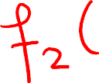












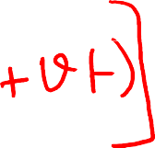





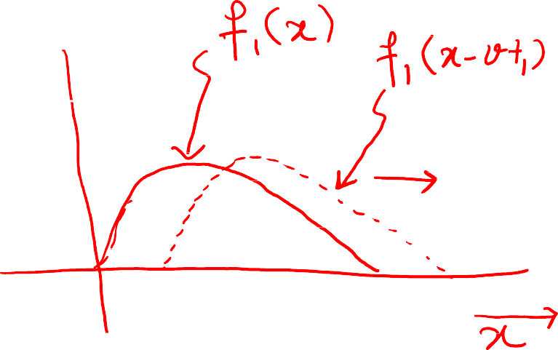



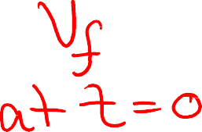


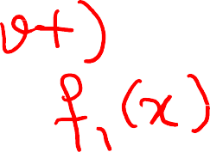



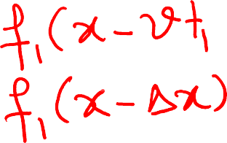

Slide 2


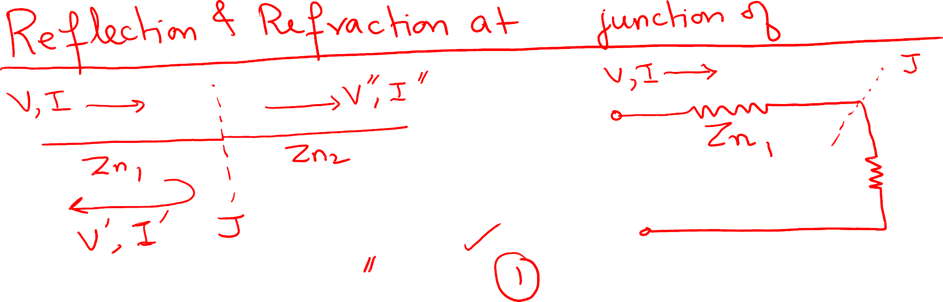

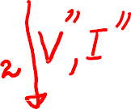
















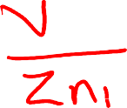

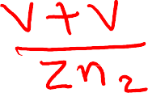


Slide 3


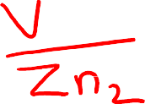



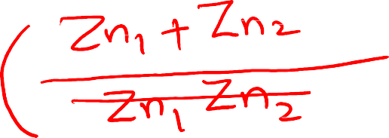





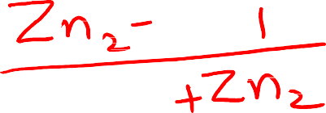

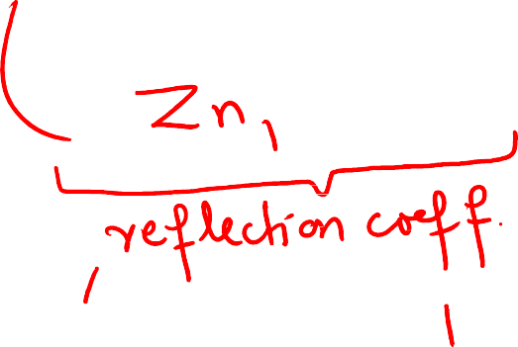
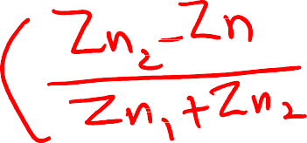



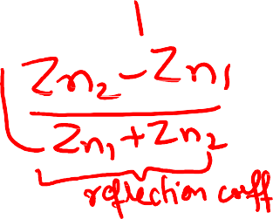



Slide 4













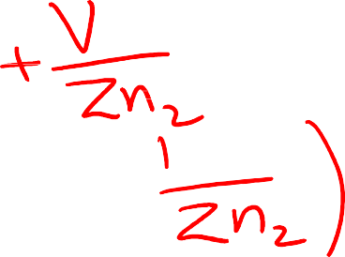





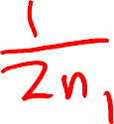



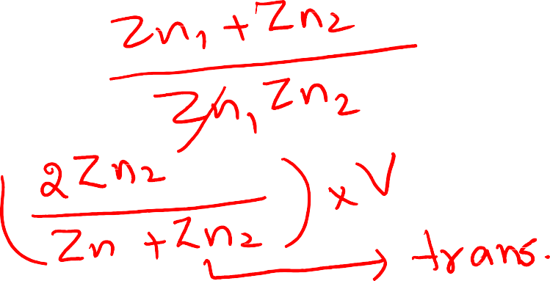
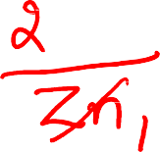



Slide 5

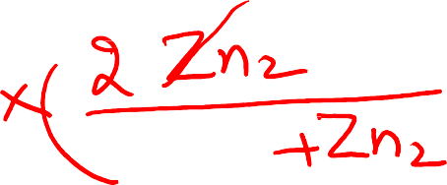






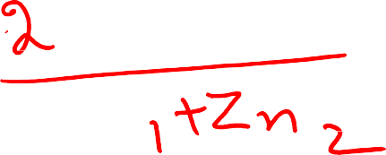
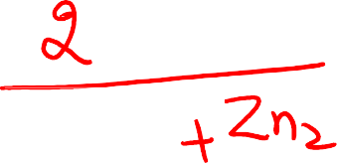






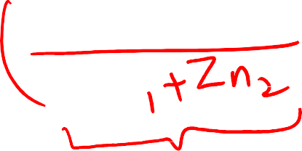



Slide 6




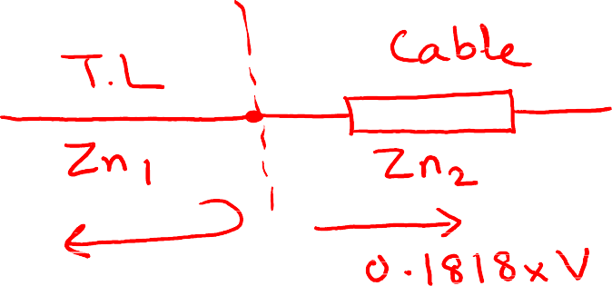






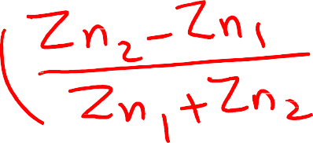



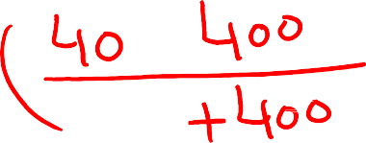



Problem: An overhead transmission line with Z_{n} = 400 ohms is connected to an underground cable having Z_{n} = 40 ohms. A voltage surge of 100 kV is injected on the overhead line and cable. Calculate:
reflected voltage and current at the junction
voltage and current in the cable

Slide 7



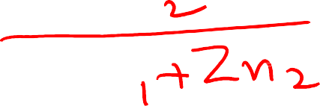


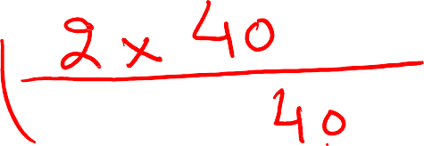











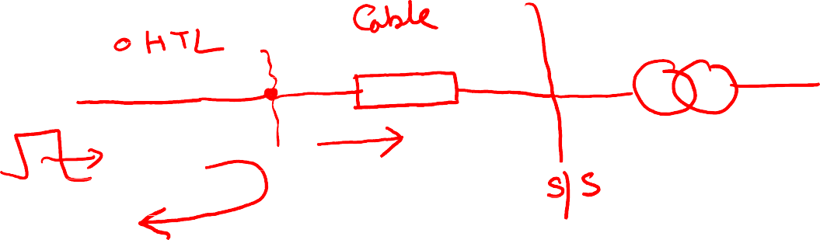

Slide 8

















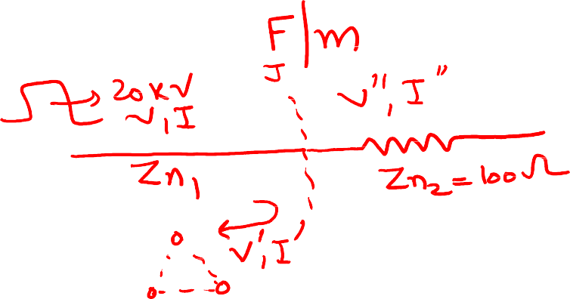



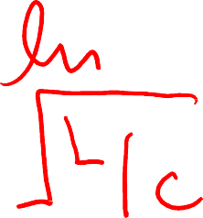





Problem: A 3-phase, overhead transmission line has equilateral spacing of 1.5 m, radius of each conductor is 10 mm. At the receiving end of the line, a resistive load of 100 ohms is connected in Y-configuration when a voltage surge of 20 kV is applied on the transmission line. Calculate:
power consumed by the load
power reflected
impedance of load at which there is no reflection

Slide 9

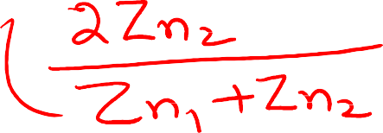











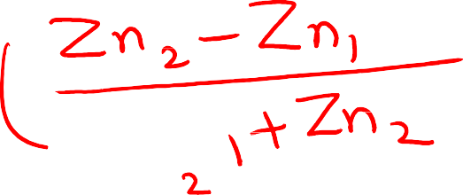









Slide 10

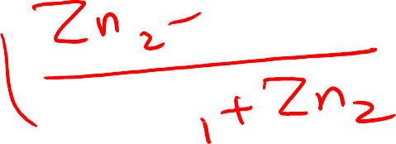














Slide 11


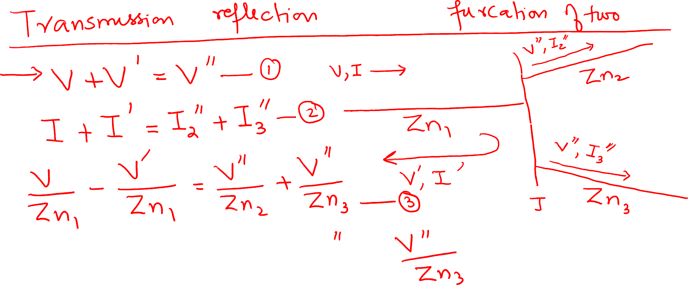




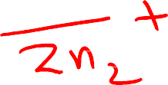

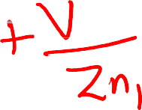
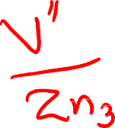







Slide 12

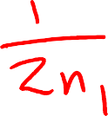

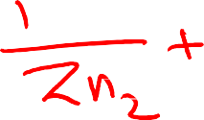
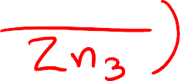

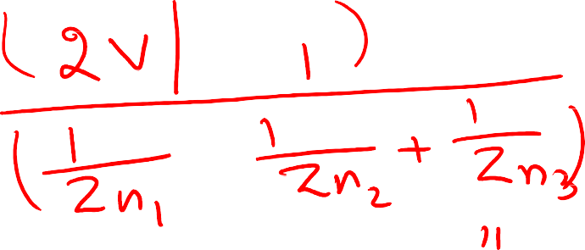









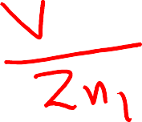
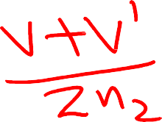
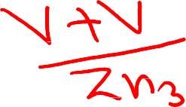


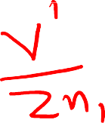


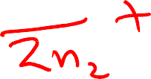




Slide 13
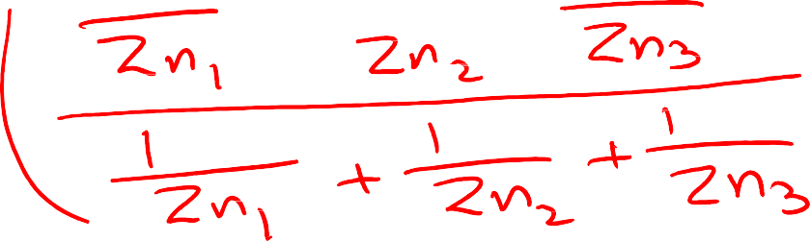



Slide 14

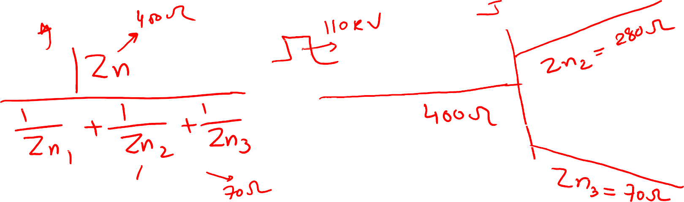









Problem: A 3-phase, overhead transmission line has natural impedance of 400 ohms. The line is bifurcated into two lines with natural impedances 280 ohms and 70 ohms. A voltage surge of 110 kV is incident to the line of natural impedance of 400 ohms and travelling towards the other two lines. Calculate the voltage and current in the line of impedance 280 ohms and 70 ohms.

Slide 15















Slide 16





























Slide 17
























Slide 18















Slide 19




























A lossless transmission line having natural impedance of 40 ohms is terminated on a load of 120 ohms. The source is a DC generator supplying 240 V and generator impedance can be neglected. Plot the variation of receiving-end voltage with time till the end of 7T where T is the time required for the voltage wave to travel the length of line.

Slide 20



Slide 21






























A C.B closes and switches an energized transformer on an overhead transmission line in series with a cable connected to an unloaded transformer. When the CB is closed at t= 0, voltage of supply transformer is at its peak. The following characteristics apply:
OHL: Z_{n} = 400 ohms L = 3000 m
v = 3 × 10⁵ km/s T = 10 μs
Cable: Z_{n} = 40 ohms L = 100 m
v = 1 × 10⁵ km/s T = 1 μs
Plot the variation in the voltage at the terminals of transformer up to 13 μs.

Slide 22


















Slide 23



